Slide 1

120 years of Olympic History Athletes and Results
DSC 530 – Exploratory Data Analysis
Fall 2020
Manish Kalkar

Slide 2
Introduction
The Olympic Games are considered the world's foremost sports competition with more than 200 nations participating. This is a historical dataset on the modern Olympic Games, from Athens 1896 to Rio 2016. Based on this historical data, the odds of winning a medal could perhaps be given based on a few biological attributes of the athletes. We are going to perform Exploratory Data Analysis on this dataset to explore the evolution of Olympic sports and visualize patterns within the dataset.

Slide 3
Research Questions
How many different athletes participated in the Olympic games since the beginning of the games? How many of them won the medals?
How many Gold, Silver and Bronze medals have been earned throughout these 120 years?
What are the number of medals each country got?
How many women and men have been participating in the Olympic Games and their Age Distribution?
What was female representation like in the Olympics throughout the century?
What is the probability distribution of height and weight?
What sports have the heaviest and tallest players, and which have the lightest or shortest?
Are there any sports that lost the Olympics’ favor and stopped being played?
Are there any new sports have been introduced to the Olympics?
What about the most diverse sports, with winners from many different countries?

Slide 4
Data Collection
This is a historical dataset on the modern Olympic Games, including summer and winter Olympics from Athens 1896 to Rio 2016. The data has been scraped from www.sports-reference.com in May 2018. The source of the data is free on Kaggle and can be downloaded from the link below:
https://www.kaggle.com/heesoo37/120-years-of-olympic-history-athletes-and-results
The athlete_events CSV file, which has a row for every competitor on every Olympics game since 1900, with their country of birth, whether they obtained a medal and so on.

Slide 5
Data Cleaning Approach
Check for missing data / Null values
Check variables names
Check for consistent data types
Check variable classification
Check misspellings / extra spaces
Check numeric data distribution
Check outliers

Slide 6
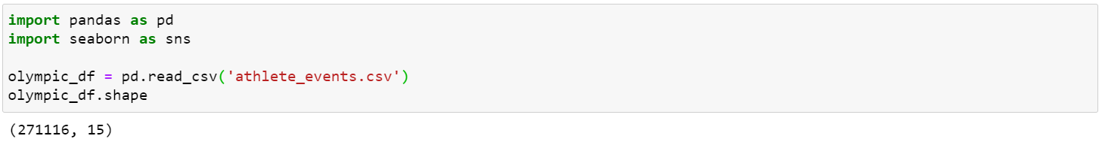
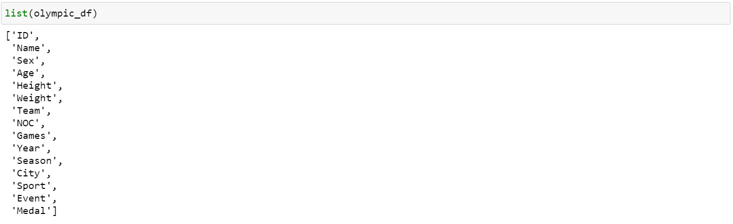
Exploratory Data Analysis Data Load - Load the data with Pandas, and check its size
The dataset has 15 different columns, and a 271116 rows

Slide 7
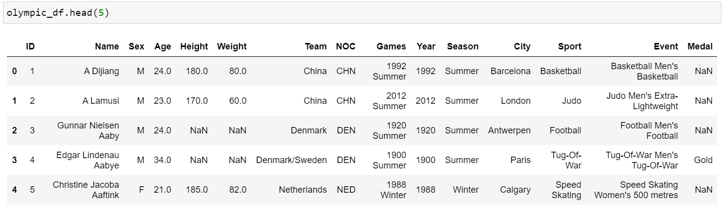
Exploratory Data Analysis How does the data look?
Top 5 rows of the dataset are displayed above.

Slide 8
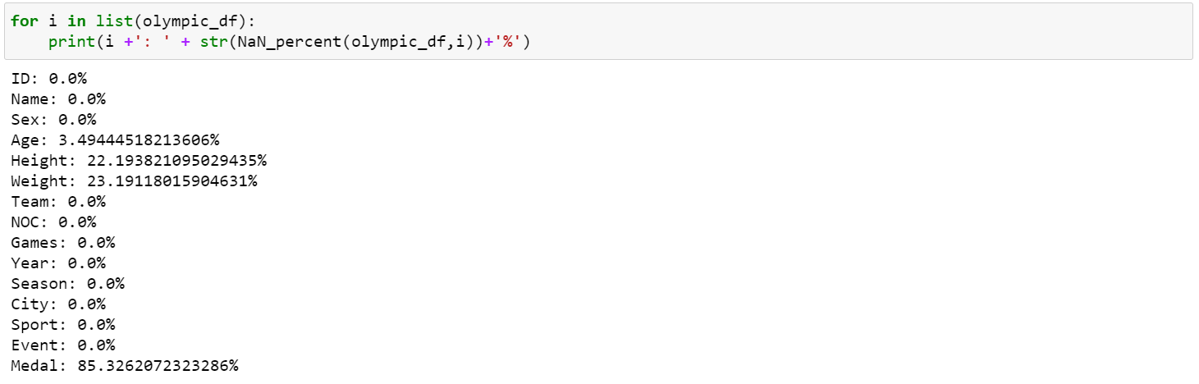
Exploratory Data Analysis Missing data / Null values
Using Pandas’ count method on a series, non-empty rows can be obtained. We see only four columns are incomplete out of all: Height, Weight, Age and Medal. Medal is incomplete any time an athlete doesn’t win a medal. It is interesting to see medals column is 85% empty, so on average only about 15% of Olympics Athletes get a medal.

Slide 9
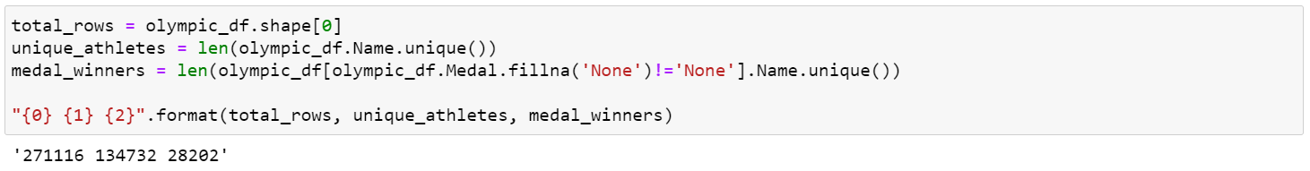
Exploratory Data Analysis How many athletes won a medal since 1900?
Almost 135 thousand different people have competed on the Olympic games in the last 120 years, but only a little over 28 thousand have earned at least one medal. That’s about one in five, which is fine. However, if you consider many athletes are actually competing in more than one category though, it does not become too optimistic.

Slide 10
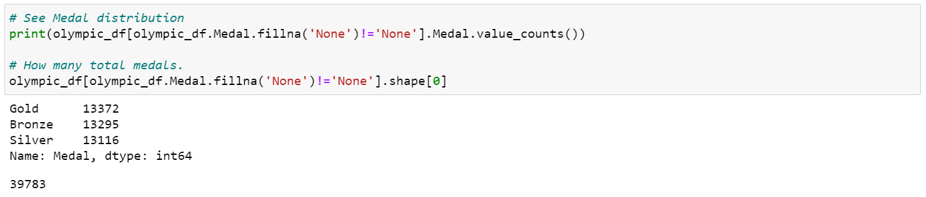
Exploratory Data Analysis How many medals have been earned throughout 120 years?
The Medal distribution is almost uniform. Almost the same quantity of gold, silver and bronze medals have been earned. However, a total of almost 39 thousand medals have been awarded, which means if top 20% of athletes that earn any medals, it is expected that those athletes earn more than one on average.

Slide 11
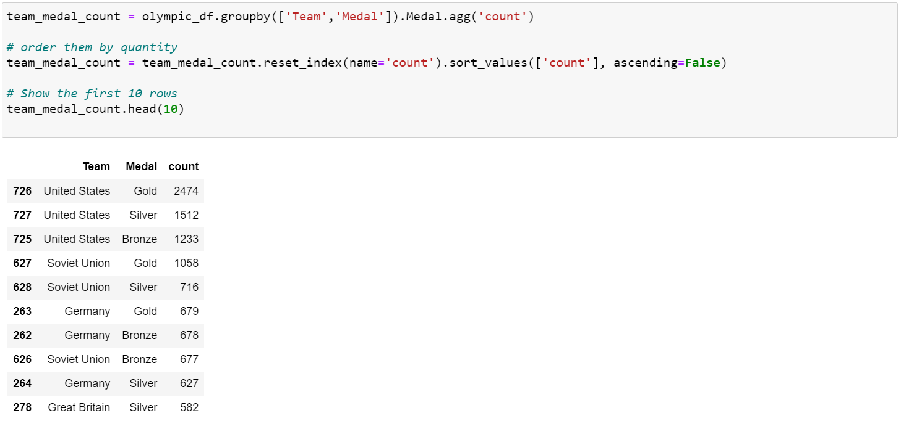
Exploratory Data Analysis Medal distribution by countries - Number of medals by each country
By fetching the head of the Pandas DataFrame we may see the countries with the most medals. First spot is for the USA - in all categories, and third spot is for Germany. Interestingly, the second country to ever earn more medals is still the Soviet Union, even though it has not been around for almost 20 years.

Slide 12
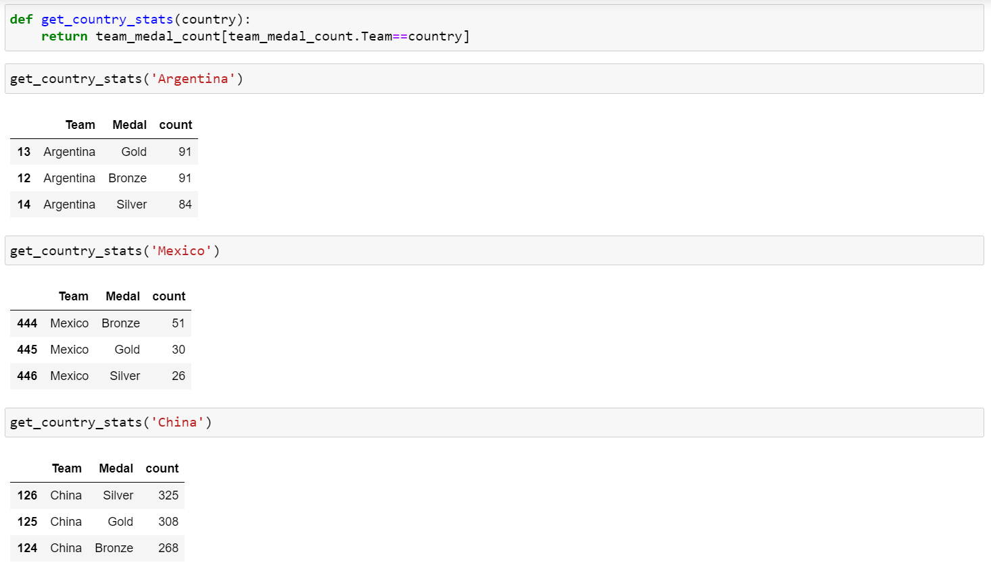
Exploratory Data Analysis Medal distribution by countries - Continued
Using the function, we could get the amount of medals of each type a certain country got. I looked into Argentina, Mexico and China.

Slide 13
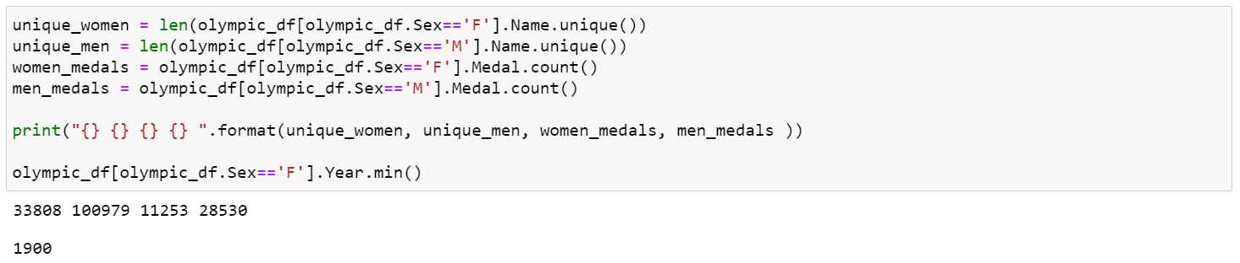
Exploratory Data Analysis Men and Women participation
It was surprising to see women participated in the games ever since as early as 1900.
Women participation is 33,808
Men participation is 100,979.
That means, there have been three men in the Olympics for every one woman.
Total number of medals women won are 11,253
Total number of medals men won are 28,530

Slide 14
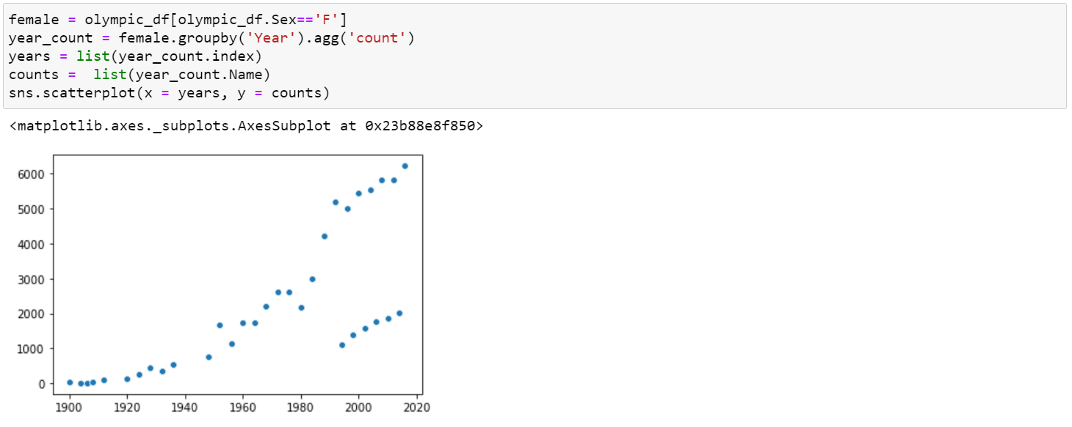
Exploratory Data Analysis Women participation – Time Series Analysis – Scatter Plot
We can see female participation has been ramping up very fast these past few decades, starting from almost zero and reaching the thousands.

Slide 15
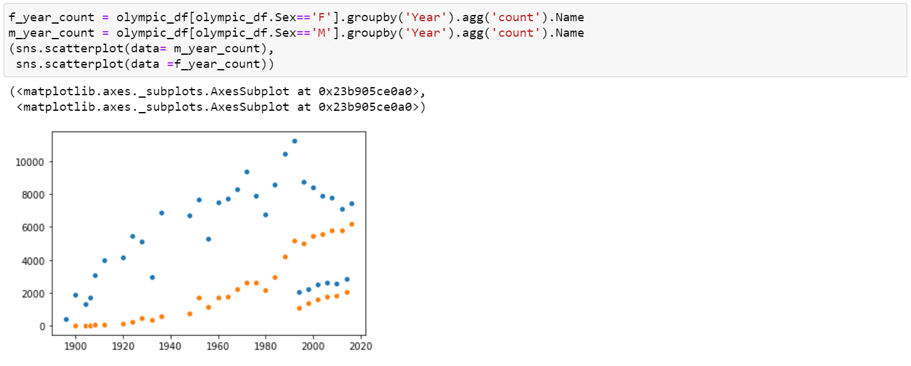
Exploratory Data Analysis Men vs. Women participation – Time Series Analysis – Scatter Plot
We can clearly see how a pattern emerges. Women are fast approaching men in numbers. Little dots below, to the right indicate Winter Olympics. The picture looks optimistic for female representation, even though there has not been a single year with more female participants than male yet.

Slide 16
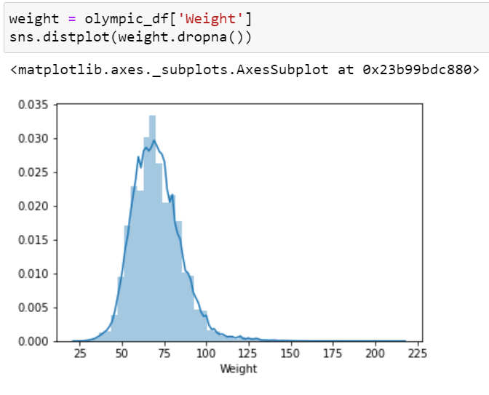
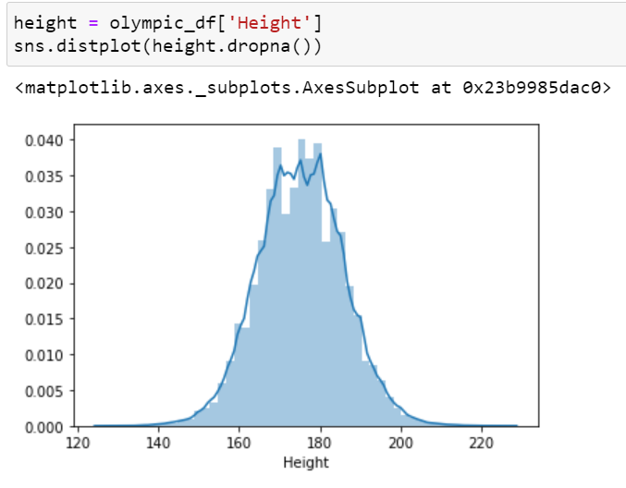
Exploratory Data Analysis Weight and Height of Athletes – Histogram with Analytical Distribution
Weight has been measured in Centimeters and Weight in Kilograms. Height is more of the normally distributed for most sports whereas, weight is skewed on the right.

Slide 17
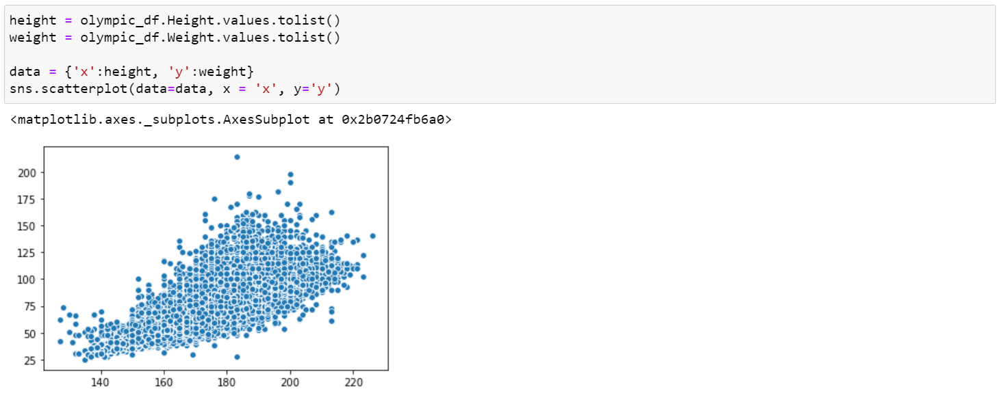
Exploratory Data Analysis Distribution between Height and Weight – Scatter Plot
Weight has been measured in Centimeters and Weight in Kilograms. Athletes have the biggest concentration between 175 cm and 200 cm as well as 80kg to 90kg.

Slide 18
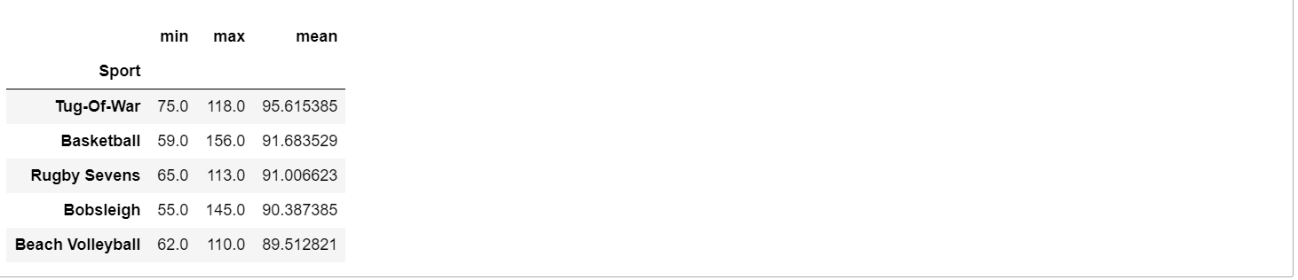
Exploratory Data Analysis What sports have the heaviest and tallest players, and the lightest or shortest?
We have more data on the male athletes than the female ones. So we have done the analysis on the male ones. Tug-of-war practitioners, Basketball players and Rugby players are all heavy. It’s quite interesting to see there’s so much variation in Basketball and Rugby players, going from 59 to 156 kg, whereas most tug of war players are over 80 kilos.

Slide 19
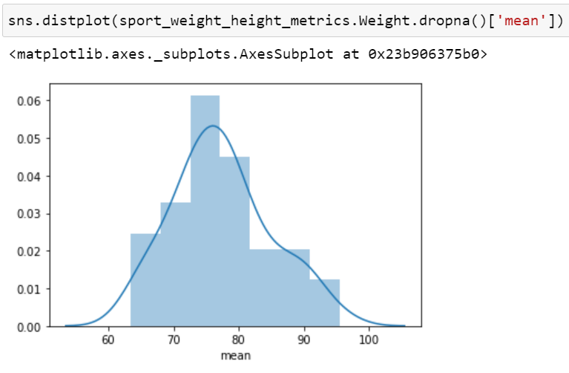
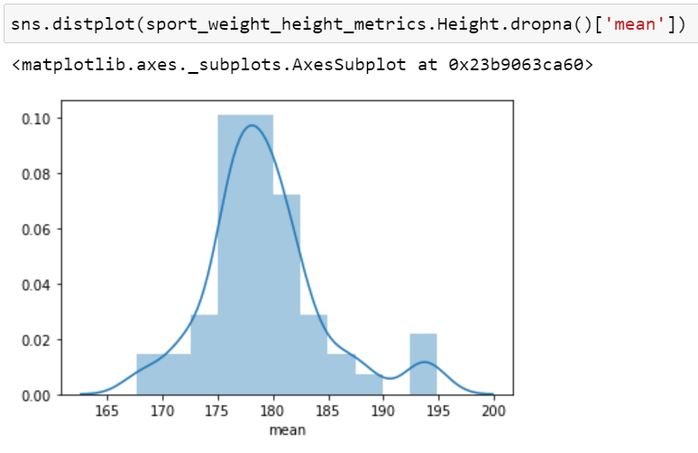
Exploratory Data Analysis Histogram - Mean weight and Mean height for each sport
Mean weight for each sport has normal distribution. The height has a similar, normal distribution, but its variance is a lot smaller, being highly concentrated in the mean.

Slide 20
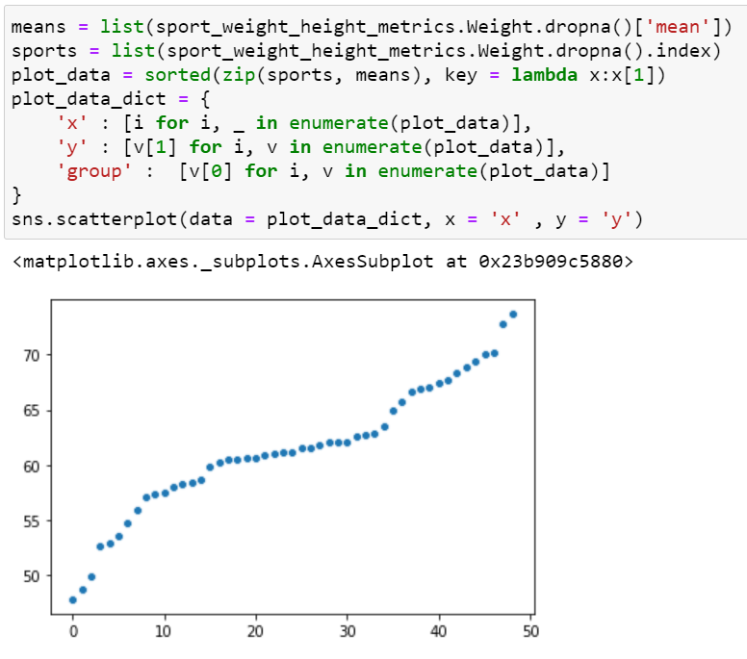
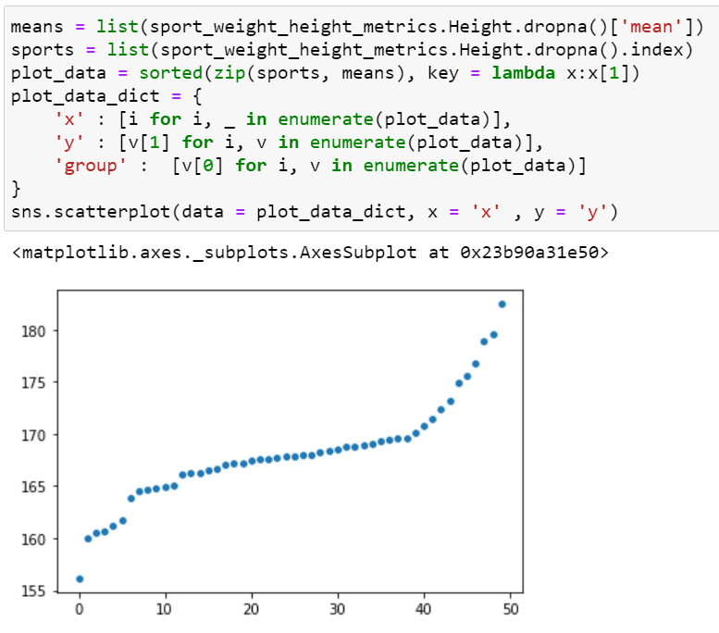
Exploratory Data Analysis Scatter plot to identify the outliers
The heaviest sport is quite the outlier with respect to the rest of the graph, and the same is the case with the lightest sport. If we look at heights, even though variance was clearly smaller, the plot reveals an even bigger difference between outliers and people near the mean, accentuated by the fact that most people do not really deviate a lot from it.

Slide 21
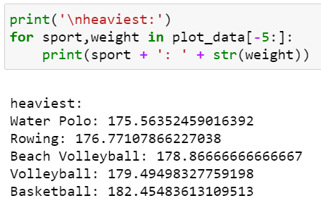
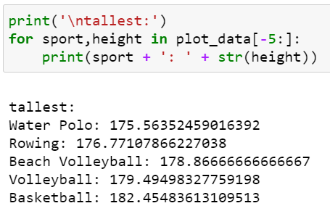
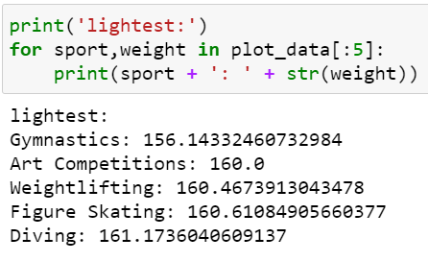
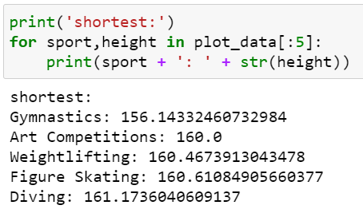
Exploratory Data Analysis Sports that have the heaviest and tallest players, and the lightest and shortest
Gymnastics athletes, even the male ones, are by far the lightest (and shortest) players. They are followed closely by Art Competitions, Weightlifting (surprising result), Figure skating and Diving.

Slide 22
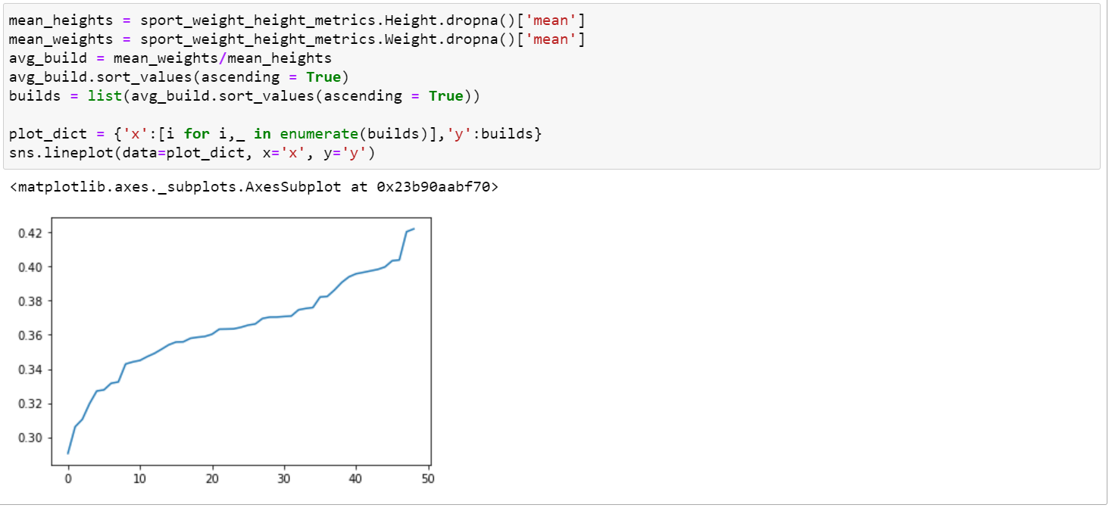
Exploratory Data Analysis Build (weight/height) per each sport
The plot has a linear look, until we get to the top where most outliers fall.

Slide 23
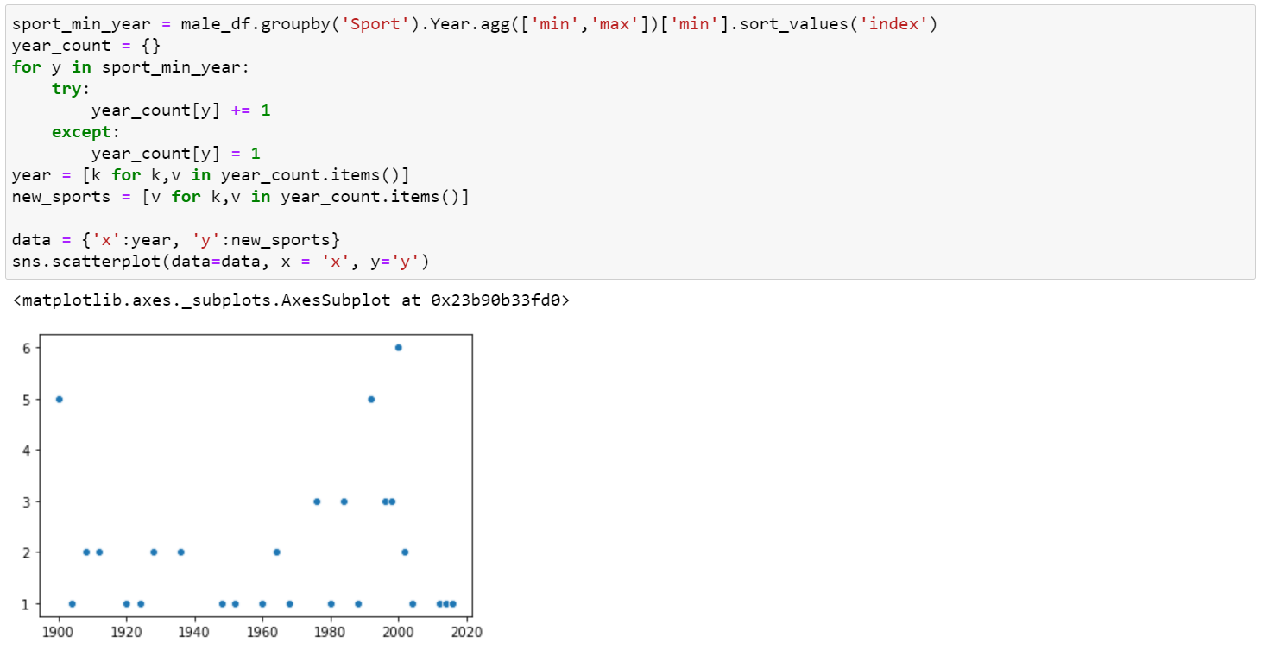
Exploratory Data Analysis New sports introduced each year in Olympics
The above graph shows us how many sports were practiced in the Olympics for the first time for each year. In other words, how many sports were introduced each year.

Slide 24
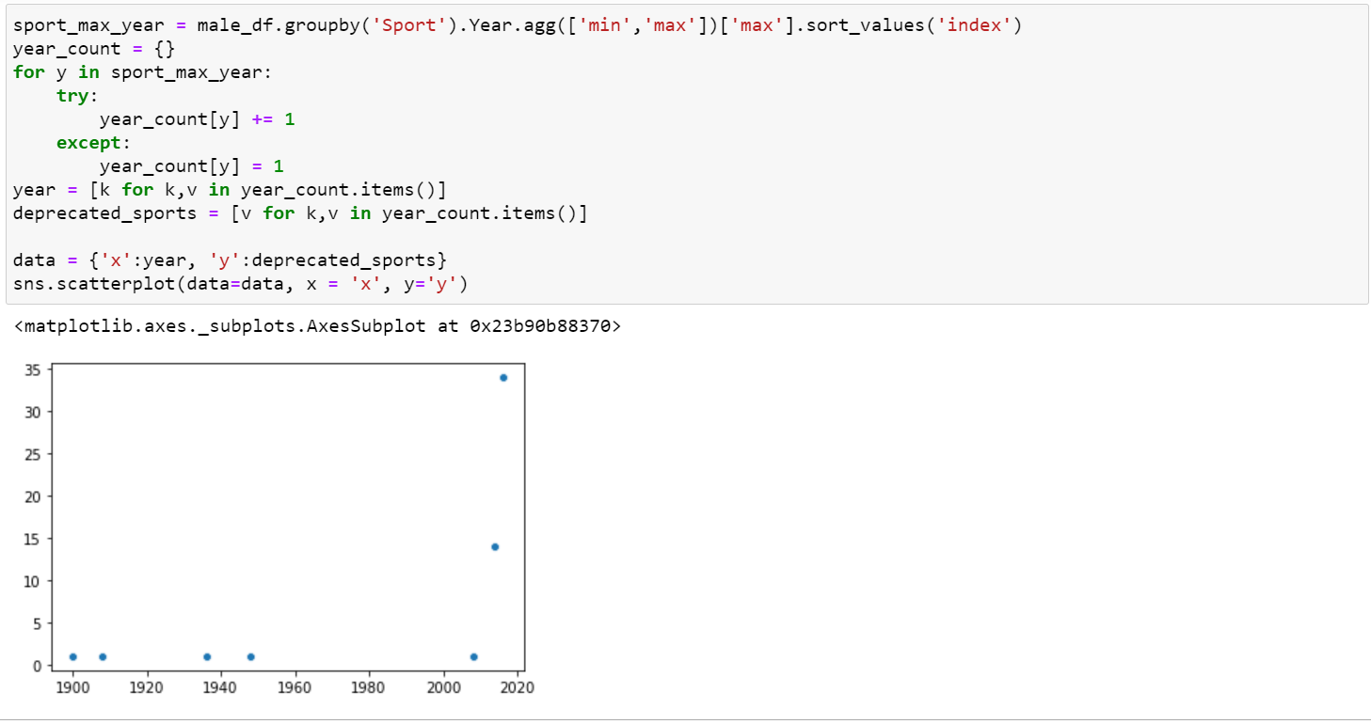
Exploratory Data Analysis Disapproved sports from Olympics
The above graph shows us how many sports were disapproved from the Olympics for each year. Early 1900, mid century and the start of 2000 shows the sports have been disapproved.

Slide 25
Conclusion
What can 120 years of Olympic history tell us about the Games?
Firstly, countries such as USA, Italy and Japan are in the Top 10 of countries with more participants and sports like Athletics, Gymnastics and Fencing are the most popular within the Athletes and all over the years. Secondly, that the Olympic Games have been led by Male Athletes, but we can see that year after years that women start to be more involved. Finally, the distribution weight vs height have been changed through the years, for men to be taller and heavier and for women to be smaller and thin enough for the sport that they are on, being a consistent but not drastic change over the years.

